Slide 1
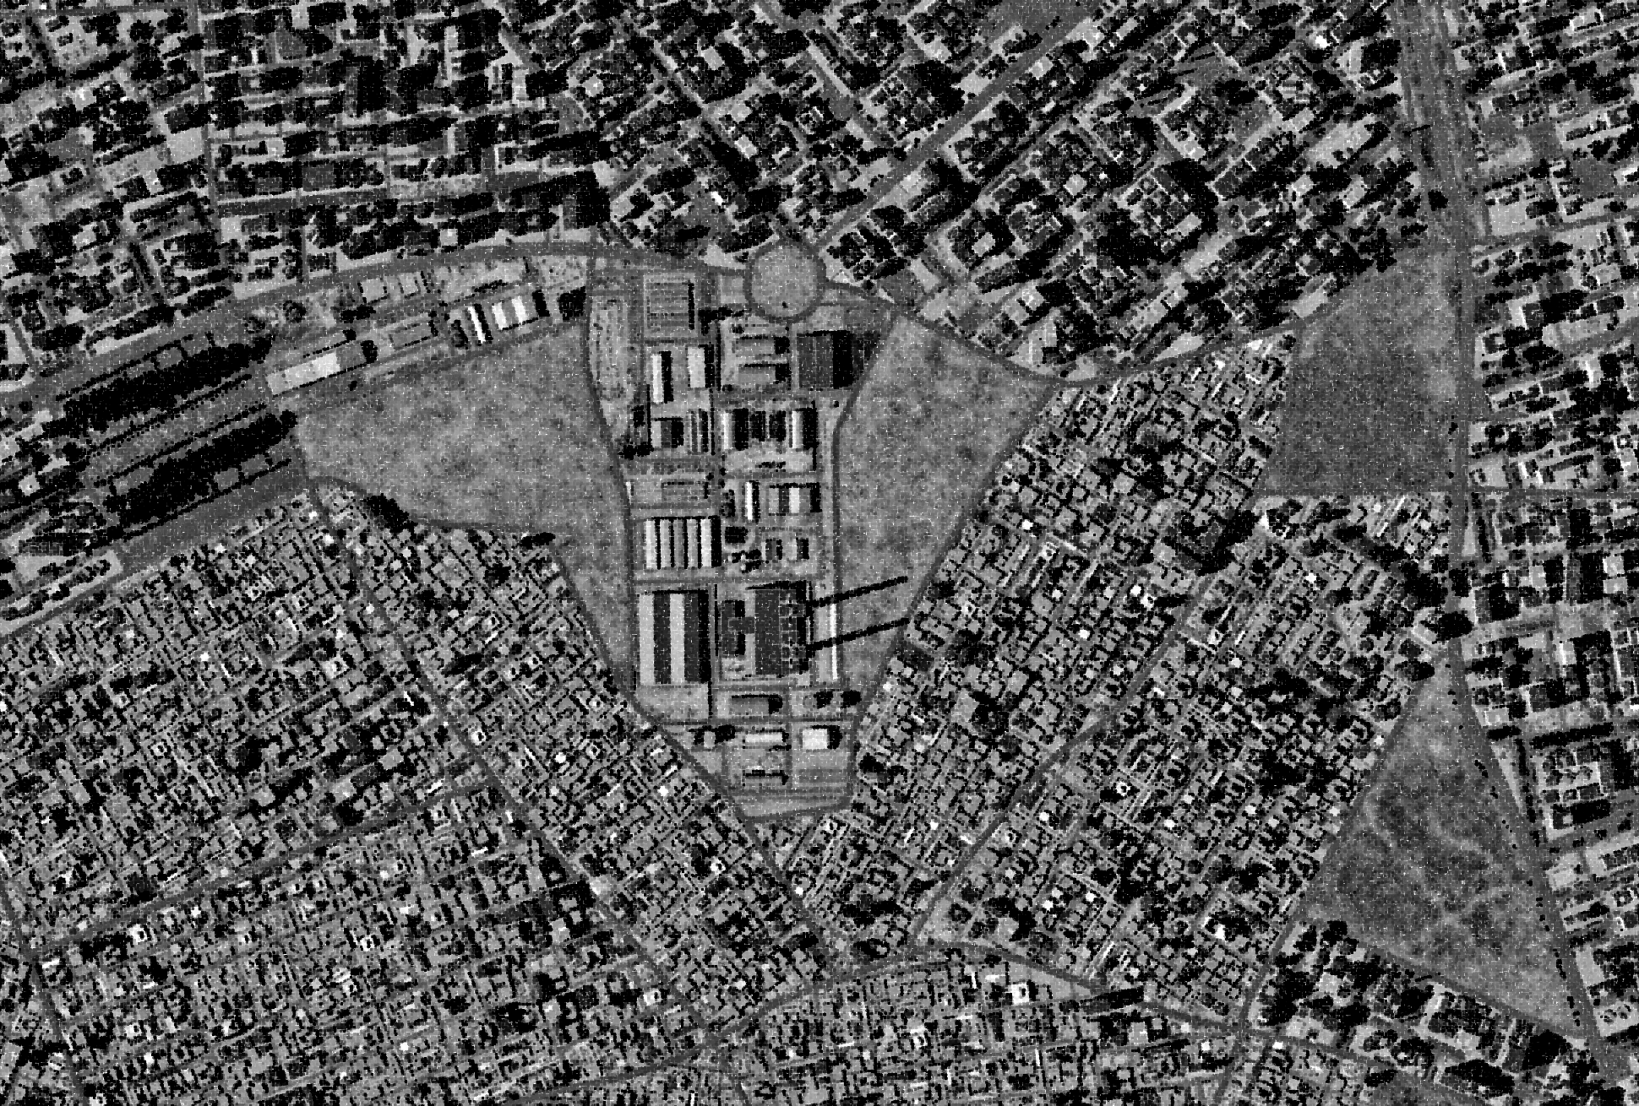
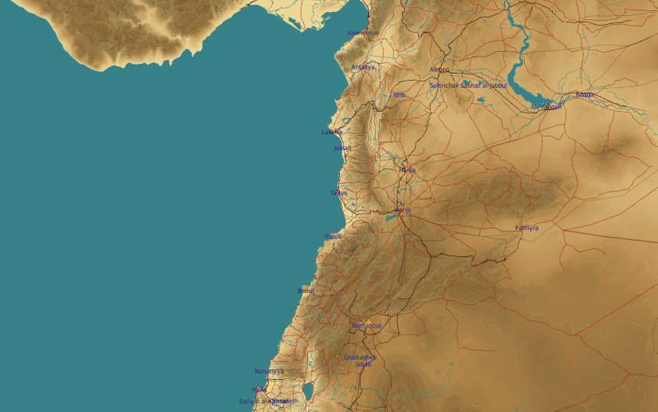
OPARTGT023 Vehicle Factory
N
23
2
4
3
2
DESCRIPTION OF THE DESIRED POINTS OF IMPACT WITH WPN TYPE:
OPARTGT023A Smelter and foundry facility
DPI 1 – N36 12.442 E 037 10.184/1361ft GBU-31(V)3/B
DPI 2 – N36 12.468 E037 10.195/1358ft GBU-31(V)3/B
Heavy structure made of slabs supported by reinforced concrete pillars. 3 storeys, flat poured concrete roof, penetrator required.
OPARTGT023B Assembly hall
DPI 3 – N36 12.588 E037 10.300/1344ft/ 1000 Ibs bomb
DPI 4 – N36 12.604 E037 10.304/1346f/t 1000 Ibs bomb
Concrete slab block 3 storeys, poured concrete flat roof.
1
5
6
Facility located in Aleppo city, surrounded by residential areas.
7
8

